Slide 1


Smart Parking Optimization

Slide 2
TEAM NAME and MEMBER DETAILS
Gitansh Saharan
Mohit Madhukar More
Sayantan Nandi
B.N. Shrikriti
Hanchate Samyukta
THEME:
Transportation and Logistics
Smart Traffic Safety Solutions: Impactful solutions to reduce traffic in Bengaluru, optimise parking to save time and provide last mile connectivity to the commuters.

Slide 3
PROBLEM STATEMENT
1.Traffic arising from automobiles searching for vacant parking spaces is prominent with increasing vehicle size and confined parking spaces in urban cities
2.Drivers also spend a signiﬁcant amount of time looking for parking, overpay for what they use, and pay a high amount of parking ﬁnes.
3.Searching for a parking space is a routine (and often frustrating) activity for many people and this search burns about one million barrels of the world's oil
Through our application we intend to solve these listed problem and make the parking system more optimized.

Slide 4
SOLUTION
Smart Parking systems typically obtain information about available parking spaces in a particular geographic area and process in real-time to place vehicles at available parking spots. This solution uses Computer Vision and Image Processing to identify available parking spaces from parking lot camera images.
How it helps to solve the problem?
It identifies all parking spaces in a parking lot from the camera images and detecting empty parking spaces from a new image input to the system using locations of parking spaces identified in the previous phase.
What are the impact metrics that one can use to analyze the effect of the solution?
It will save Time
It will Optimize the process
It will Save fuel consumption used while waiting
It will solve the chaotic parking management

Slide 5
Frameworks/Tools/Technologies stacks to be used
Library,Tensor ,flowCv2 ,Numpy and yml
Assumptions, constraints, and solution decision points (Reason behind choosing a technology)
solution treats the problem as an instance segmentation problem to identify cars from an image of a parking lot and infer empty parking spots in the image.
The first part of the problem is to identify all parking spaces in a parking lot from the camera images.
The second part works on detecting empty parking spaces from a new image input to the system using locations of parking spaces identified in the previous phase.
How easily can your solution be implemented and how effective will it be?
Our solution can be implemented in all the busy parking plots where people find it difficult to find the parking spot
Extent of Scalability/Usability
We can update real-time data for parking status to firebase database and make a dashboard to visualize which spots are empty n occupied

Slide 6
METHODOLOGY
Architecture Diagram
Flow Chart

Slide 7
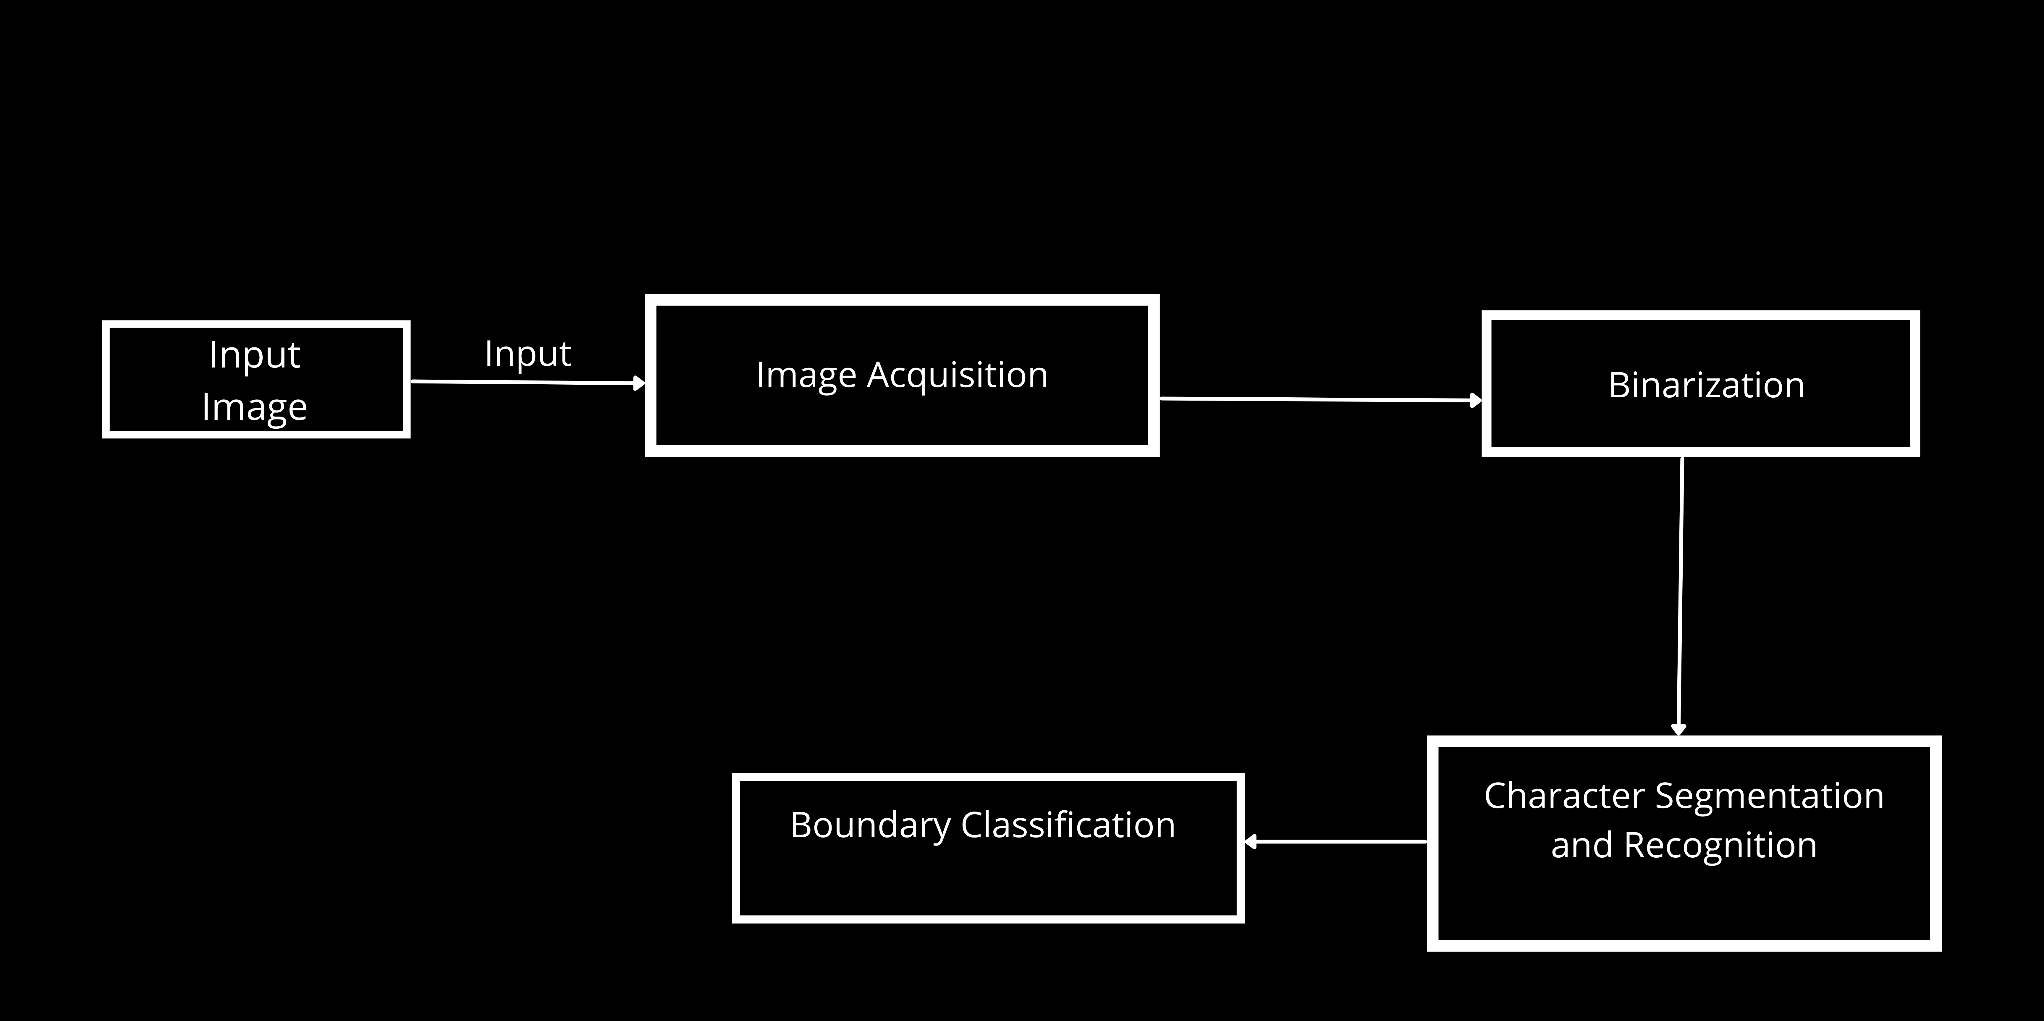
Architecture Diagram

Slide 8
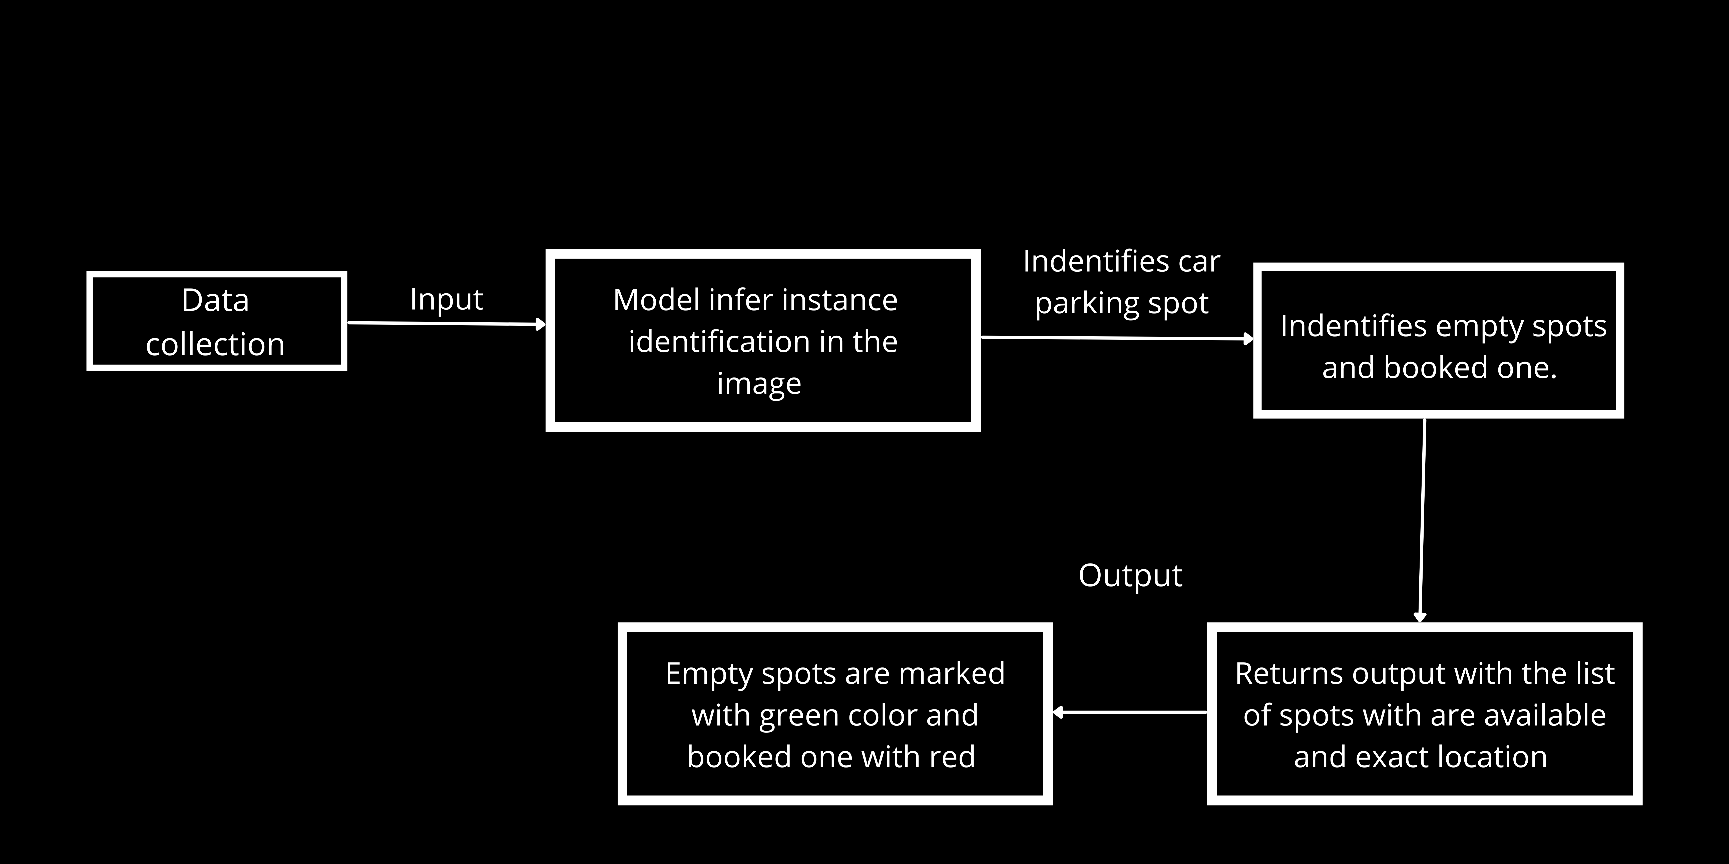
Flow Chart

Slide 9
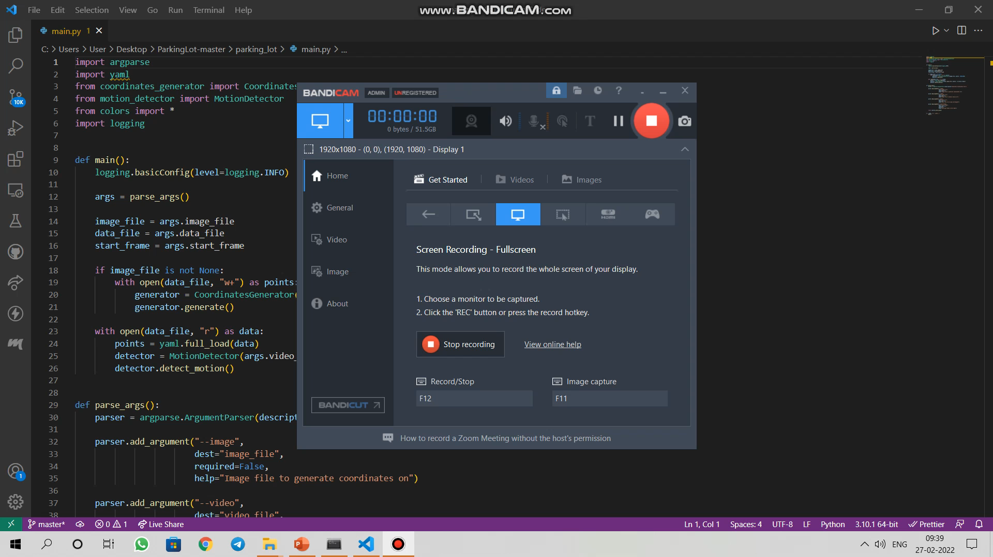
WORKING PROTOTYPE
View click here to see the video

Slide 10
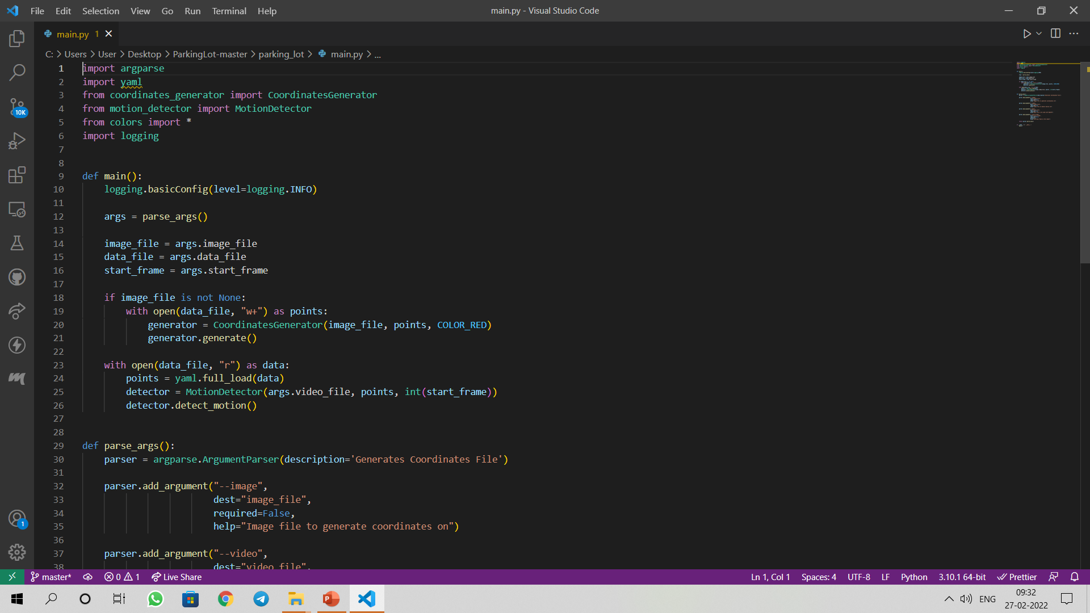
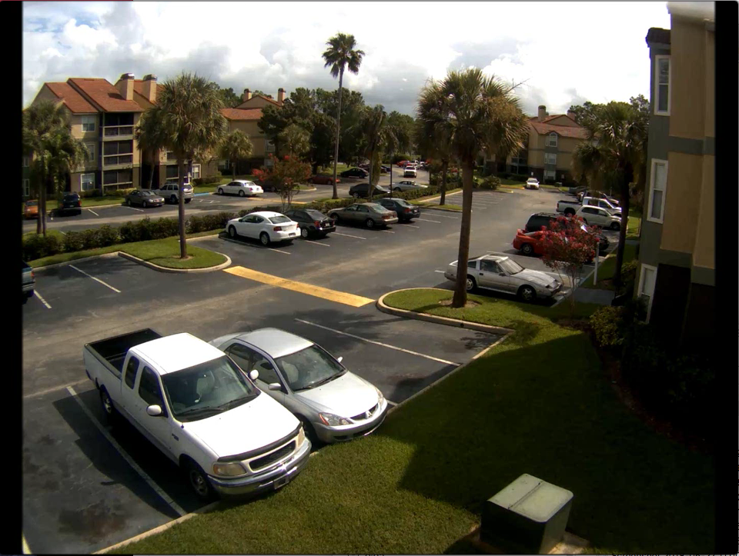
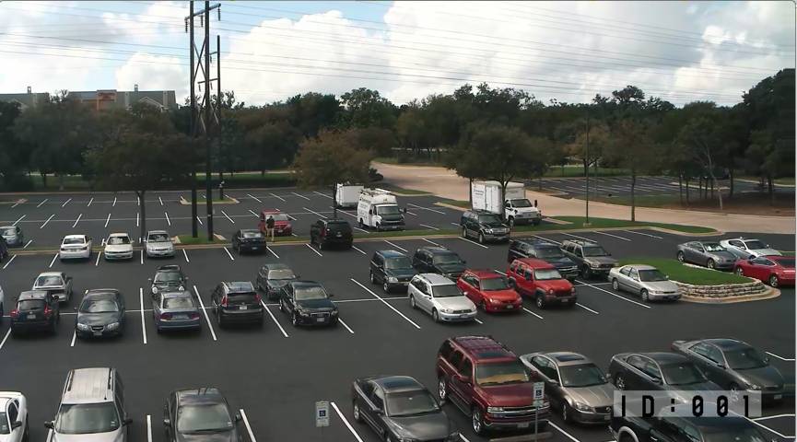
Attachments
[ App wireframe, Screenshots, ]

